Slide 1


Confidential
Financial Modeling, Planning & Analysis Toolkit
Overview

Slide 2

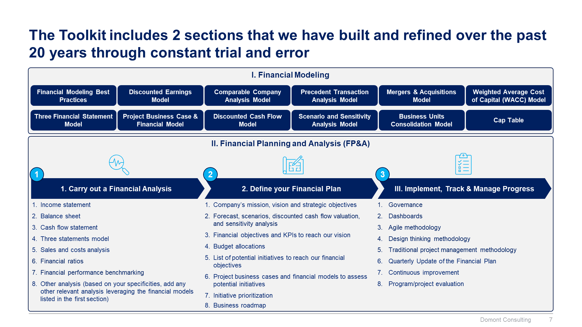
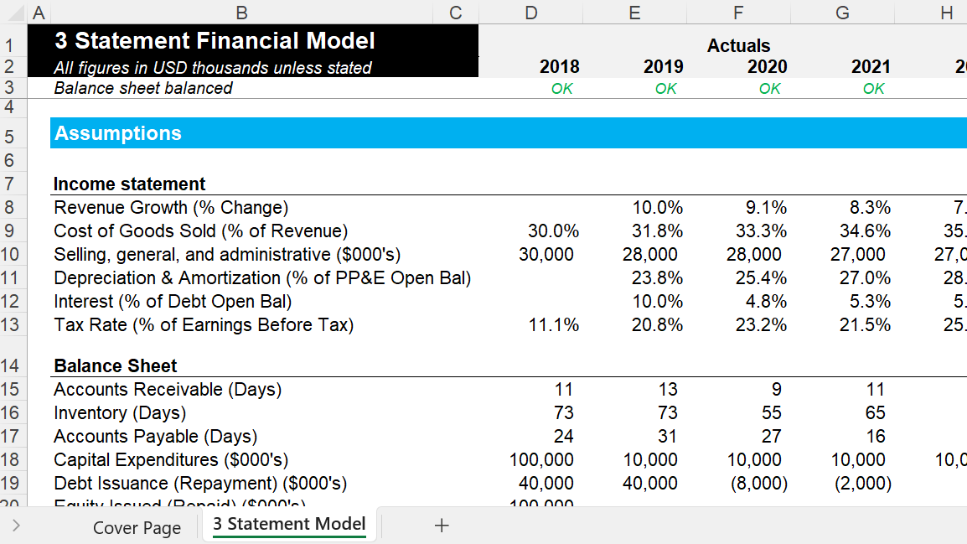
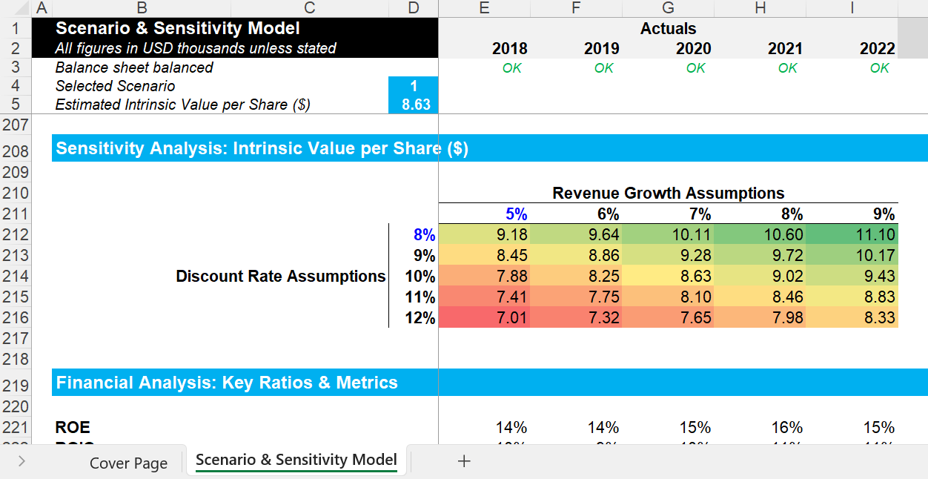
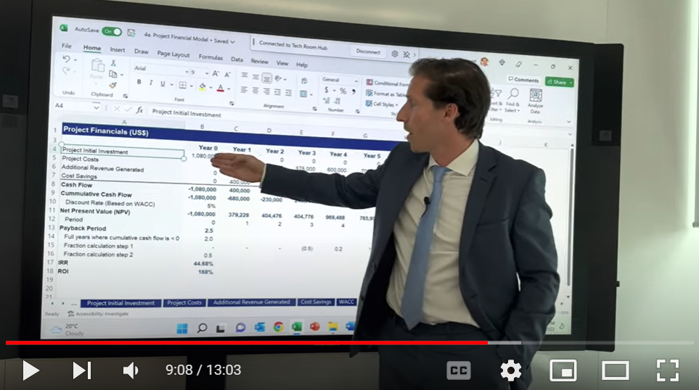
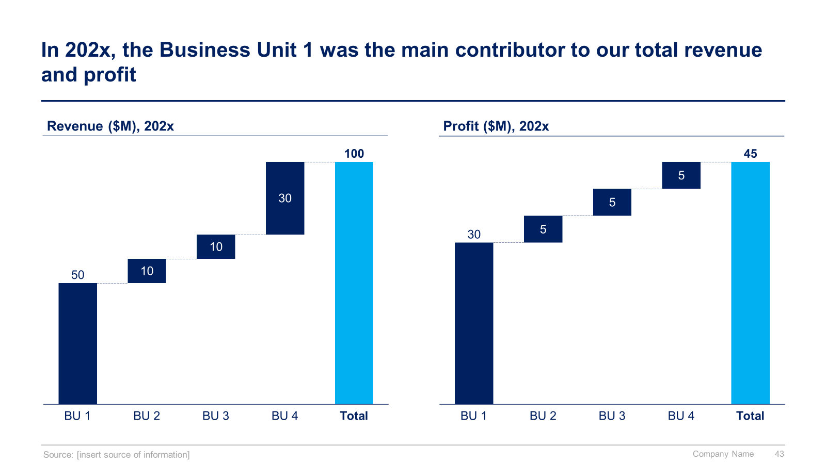
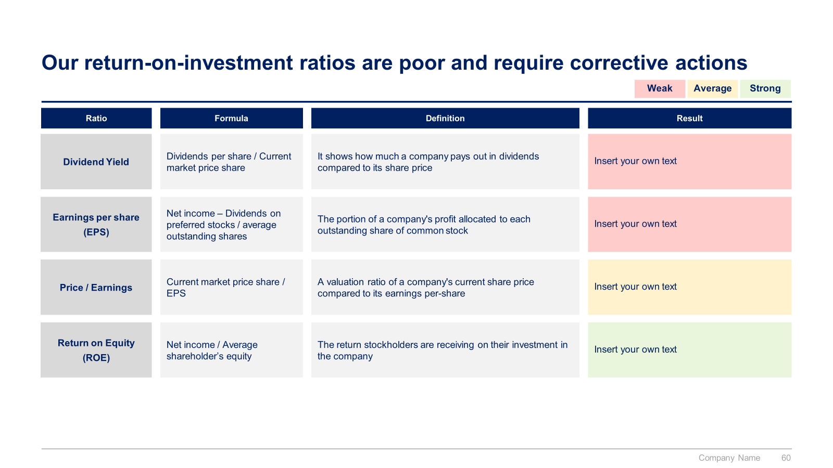
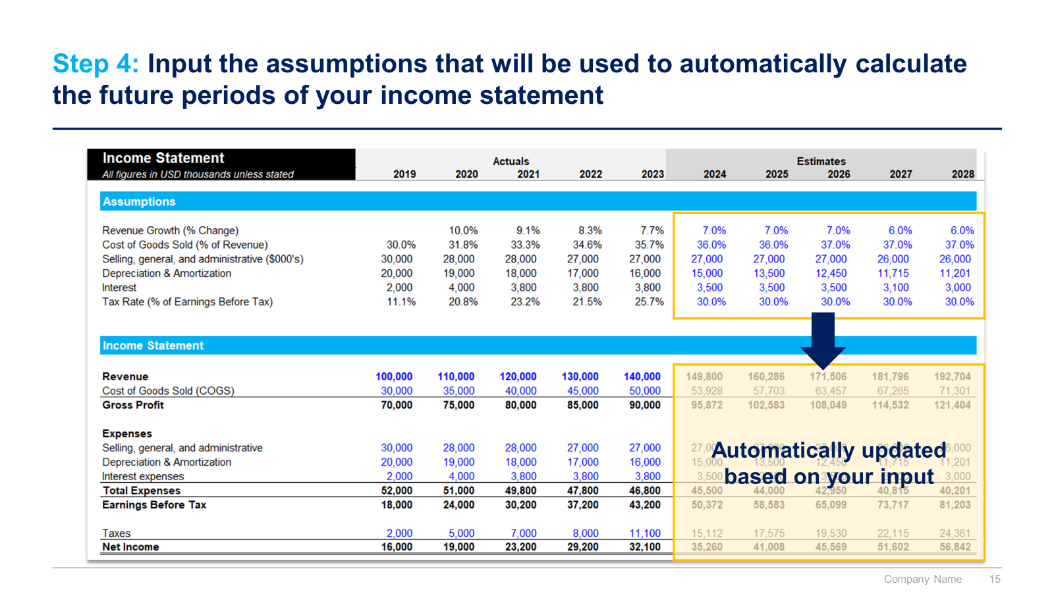
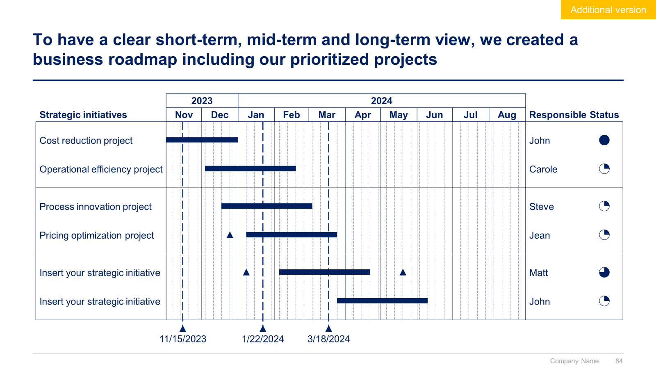

Slide 3


Introduction
This Toolkit was created by ex-JP Morgan Investment Bankers, and McKinsey & Deloitte Consultants, after more than 4,000 hours of work. It includes all the Frameworks, Best Practices & Templates required to build strong Financial Modeling, Planning & Analysis capabilities within your organization. Build a success story such as Apple and Google, who gained a competitive advantage by mastering Financial Modeling, Planning & Analysis.
Join the 200,000+ Executives, Consultants & Entrepreneurs who are already leveraging our Management Consulting Toolkits to improve the performance of their organization and boost their own career.
If you have any questions, send us an email at support@domontconsulting.com and one of our ex-McKinsey, Deloitte & BCG Management Consultants will get back to you within 2 business days.
Aurelien Domont
Management Consultant
Domont Consulting Managing Director

Slide 4

Success stories of companies that have successfully built strong financial modeling, planning, and analysis capabilities
Apple Inc. is widely recognized for its meticulous financial planning and analysis capabilities, which have contributed significantly to its success and market leadership. At the core of Apple's financial planning and analysis efforts are advanced financial models that play a crucial role in evaluating product profitability, pricing strategies, and capital allocation decisions.
One key aspect of Apple's financial modeling is its ability to accurately forecast demand for its products. By analyzing historical sales data, market trends, and various factors such as product launches and economic conditions, Apple can project future sales volumes and revenue streams. This enables the company to optimize production levels, manage supply chain costs, and efficiently handle inventory, minimizing costs and ensuring optimal profitability.
Apple's financial models also support the evaluation of pricing strategies. The company carefully considers factors such as production costs, market demand, and competitive landscape to determine optimal pricing points for its products. Through this analysis, Apple can maximize its revenue and maintain a competitive position in the market.
Capital allocation decisions are another area where Apple's financial modeling capabilities shine. The company employs sophisticated models to evaluate investment opportunities, assess risk-return profiles, and determine the most effective use of its financial resources. This enables Apple to strategically allocate capital to areas that offer the highest potential for growth and shareholder value.
Overall, Apple's strong financial planning and analysis capabilities, driven by advanced financial modeling, have been instrumental in its ability to navigate changing market dynamics, maintain profitability, and sustain its position as a global technology leader. By leveraging accurate forecasting, optimizing pricing strategies, and making strategic capital allocation decisions, Apple continues to drive innovation, deliver value to customers, and generate impressive financial performance.

Slide 5

Success stories of companies that have successfully built strong financial modeling, planning, and analysis capabilities
Google’s (now a subsidiary of Alphabet Inc.) financial modelling, planning and analysis capabilities are essential for several key areas of the business. For instance, Google's financial models play a vital role in evaluating the profitability of different business segments and product lines. The company can assess the costs associated with operating its various services, including data centers, infrastructure, and content acquisition. Financial modeling helps Google understand the cost structures and profitability drivers across its diverse portfolio, which includes advertising, cloud computing, hardware devices, and emerging technologies.
Additionally, financial modeling is crucial for Google's investment decisions and capital allocation strategies. The company evaluates potential acquisitions, strategic partnerships, and capital expenditures using financial models that assess the return on investment, discounted cash flows, and risk factors. These models help Google prioritize investment opportunities and allocate resources to areas that are expected to generate the highest financial returns and long-term growth.
Google's financial modeling and analysis capabilities are supported by a robust data infrastructure and advanced analytical tools. The company leverages vast amounts of data, including user behavior, market trends, and performance metrics, to build accurate and comprehensive financial models. By employing sophisticated quantitative techniques and statistical analysis, Google can make data-driven financial decisions, optimize its operations, and maximize shareholder value.
In summary, Google's financial modeling and analysis capabilities provide a deep understanding of the financial impact of its business initiatives, assist in evaluating profitability across various segments, and enable informed investment decisions. These capabilities play a pivotal role in Google's ability to drive growth, adapt to evolving market conditions, and maintain its position as a global technology leader.

Slide 6












Our firm created a Financial Modeling, Planning & Analysis Toolkit to help you create your own success stories
What’s inside the Toolkit?
Who created the Toolkit?
The Toolkit was created by ex-JP Morgan Investment Bankers, and McKinsey & Deloitte Consultants.
Best Practices
Frameworks
Number of professionals leveraging our Toolkits
Advice from
tier-1 Management Consultants
Tools
There are 200,000+ Executives, Consultants & Entrepreneurs leveraging our Toolkits to improve the performance of their organization
Real-life Examples
Templates
Trusted by small and large organizations
Video Training
Step-by-step Tutorials

Slide 7
Our Toolkit will help you fulfill multiple objectives
The Financial Modeling, Planning & Analysis Toolkit includes frameworks, tools, templates, tutorials, real-life examples, video training, and best practices to help you:
Build Financial Models with our ready-made Excel Models: (1) Financial Modeling Best Practices, (2) Three Financial Statement Model, (3) Project Business Case & Financial Model, (4) Discounted Cash Flow Model, (5) Scenario and Sensitivity Analysis Model, (6) Business Units Consolidation Model, (7) Discounted Earnings Model, (8) Comparable Company Analysis Model, (9) Precedent Transaction Analysis Model, (10) Mergers & Acquisitions Model, (11) Weighted Average Cost of Capital (WACC) Model, (12) Cap Table
Build strong Financial Planning and Analysis (FP&A) Capabilities with our 3-phase approach: (I) Carry out a Financial Analysis, (II) Define your Financial Plan, (III) Implement, Track & Manage Progress
(I) Carry out a Financial Analysis: (1) Income Statement, (2) Balance Sheet, (3) Cash Flow Statement, (4) Three Statements Model, (5) Sales and Costs Analysis, (6) Financial Ratios, (7) Financial Performance Benchmarking, (8) Other Analysis
(II) Define your Financial Plan: (1) Company’s Mission, Vision and Strategic Objectives, (2) Forecast, Scenarios, Discounted Cash Flow valuation, and Sensitivity Analysis, (3) Financial Objectives and KPIs to reach our Vision, (4) Budget Allocations, (5) List of Potential Initiatives to reach our Financial Objectives, (6) Project Business Cases and Financial Models to assess potential initiatives, (7) Initiative Prioritization, (8) Business Roadmap
(IV) Implement, Track & Manage Progress: (1) Governance, (2) Dashboards, (3) Agile Methodology, (4) Design Thinking Methodology, (5) Traditional Project Management Methodology, (5) Quarterly Update of the Financial Plan, (6) Continuous Improvement, (7) Program/project evaluation
Build a success story such as Apple and Google, who gained a competitive advantage by mastering Financial Modeling, Planning & Analysis

Slide 8


Video demonstration of the Toolkit
Video Demo Access
Video Demo Visual
Select “Slide Show” mode and then click on the link below or on the image on the right to access this video demo.
You can also access the video by copy pasting the following URL in your browser:
https://youtu.be/_2f4cHb2tl4

Slide 9



The Toolkit includes 2 sections that we have built and refined over the past 20 years through constant trial and error
I. Financial Modeling
Financial Modeling Best Practices
Discounted Earnings Model
Comparable Company Analysis Model
Precedent Transaction Analysis Model
Mergers & Acquisitions Model
Weighted Average Cost of Capital (WACC) Model
Three Financial Statement Model
Project Business Case & Financial Model
Discounted Cash Flow Model
Scenario and Sensitivity Analysis Model
Business Units Consolidation Model
Cap Table
II. Financial Planning and Analysis (FP&A)
1
2
3
1. Carry out a Financial Analysis
2. Define your Financial Plan
III. Implement, Track & Manage Progress
Income statement
Balance sheet
Cash flow statement
Three statements model
Sales and costs analysis
Financial ratios
Financial performance benchmarking
Other analysis (based on your specificities, add any other relevant analysis leveraging the financial models listed in the first section)
Company’s mission, vision and strategic objectives
Forecast, scenarios, discounted cash flow valuation, and sensitivity analysis
Financial objectives and KPIs to reach our vision
Budget allocations
List of potential initiatives to reach our financial objectives
Project business cases and financial models to assess potential initiatives
Initiative prioritization
Business roadmap
Governance
Dashboards
Agile methodology
Design thinking methodology
Traditional project management methodology
Quarterly Update of the Financial Plan
Continuous improvement
Program/project evaluation

Slide 10
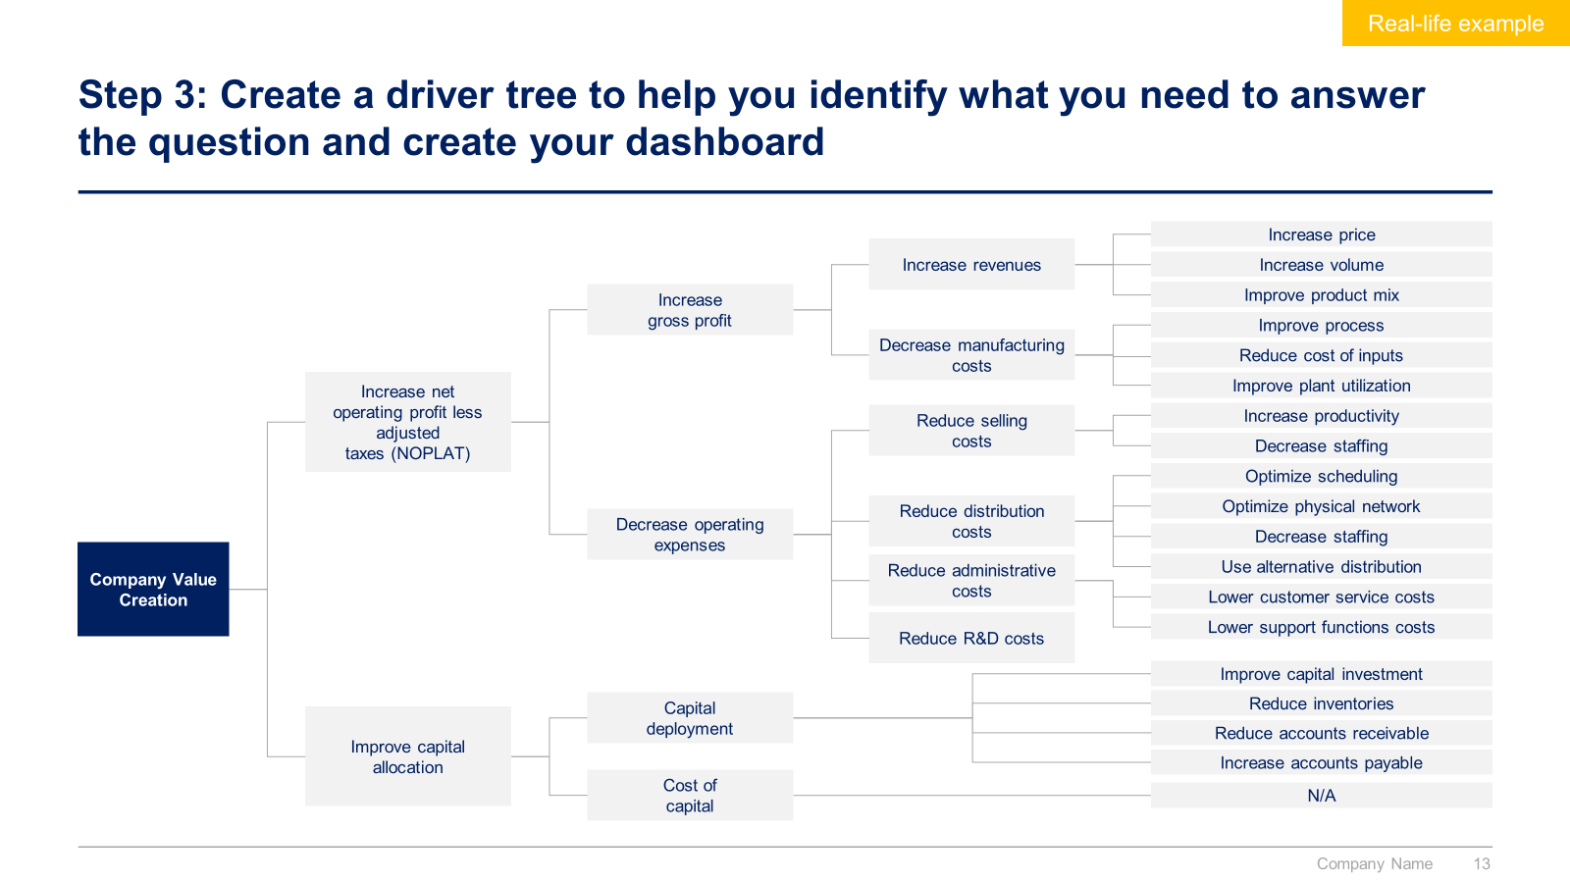
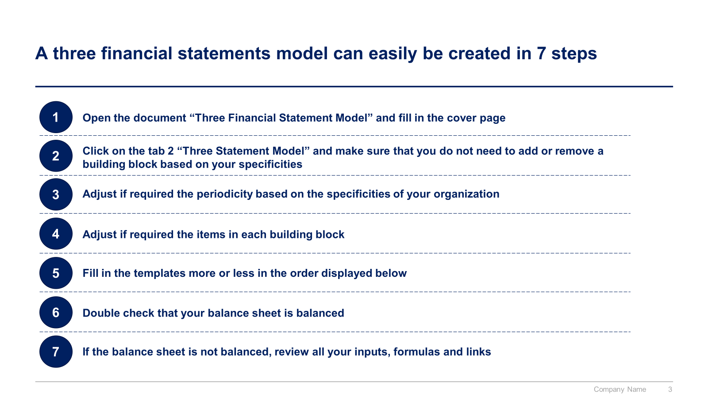
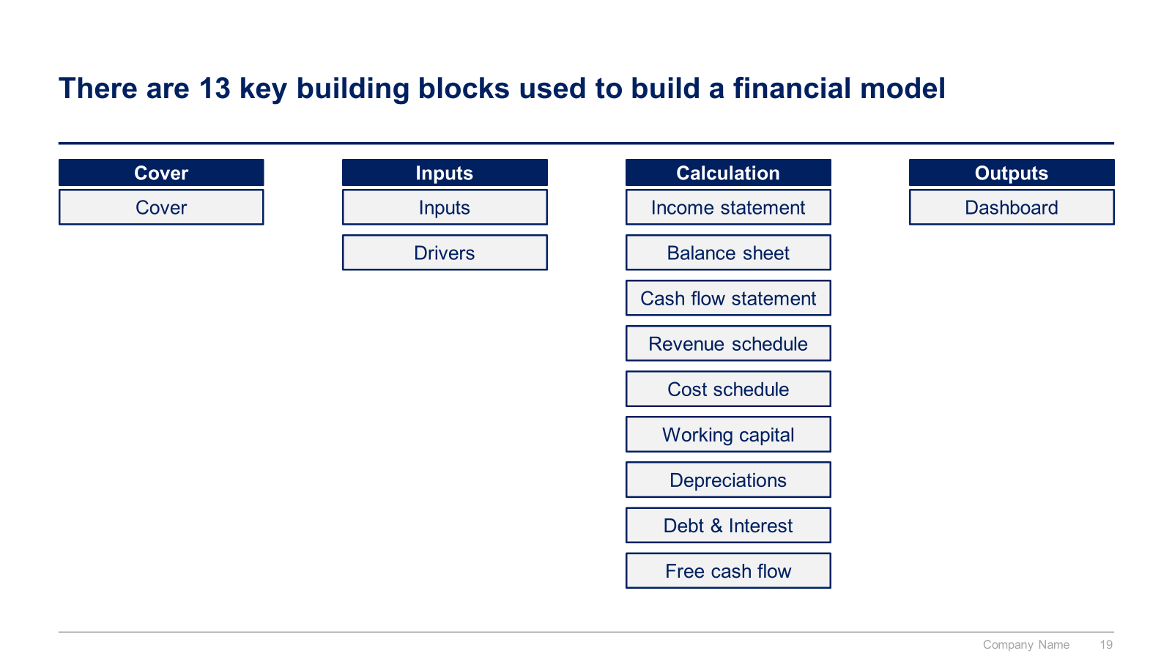
Small preview of the section I “Financial Modeling”

Slide 11
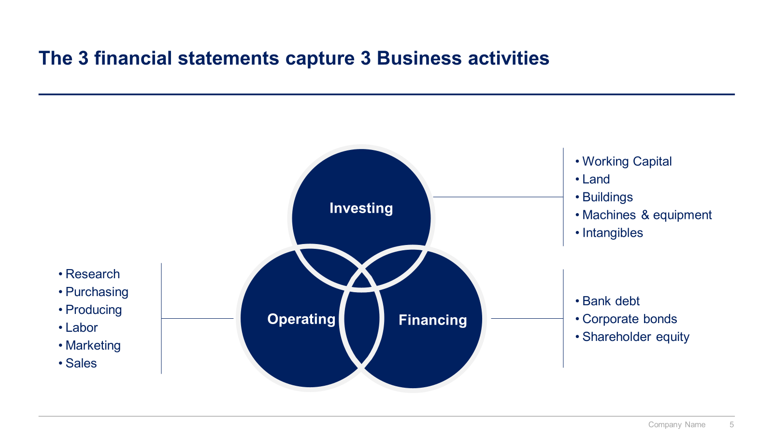
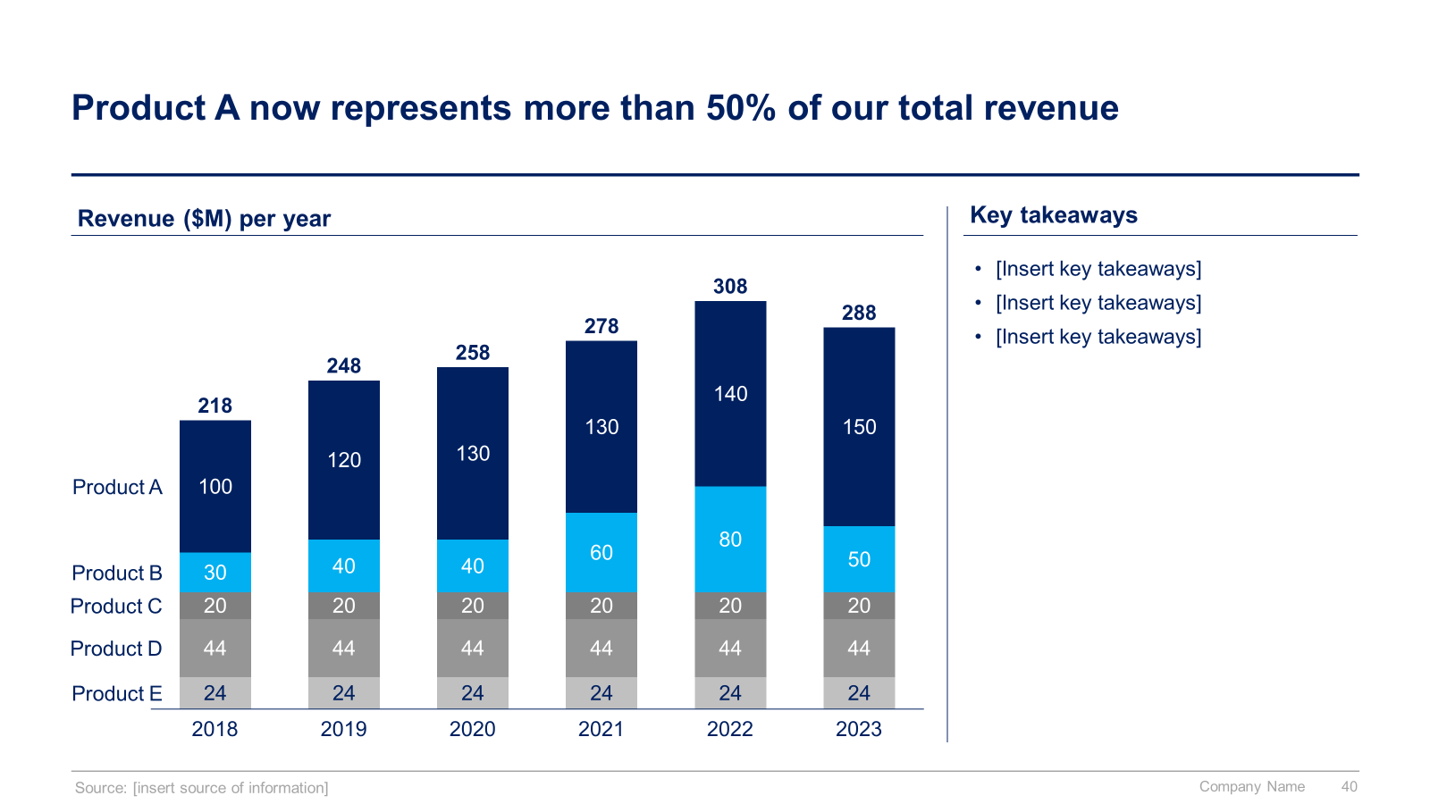
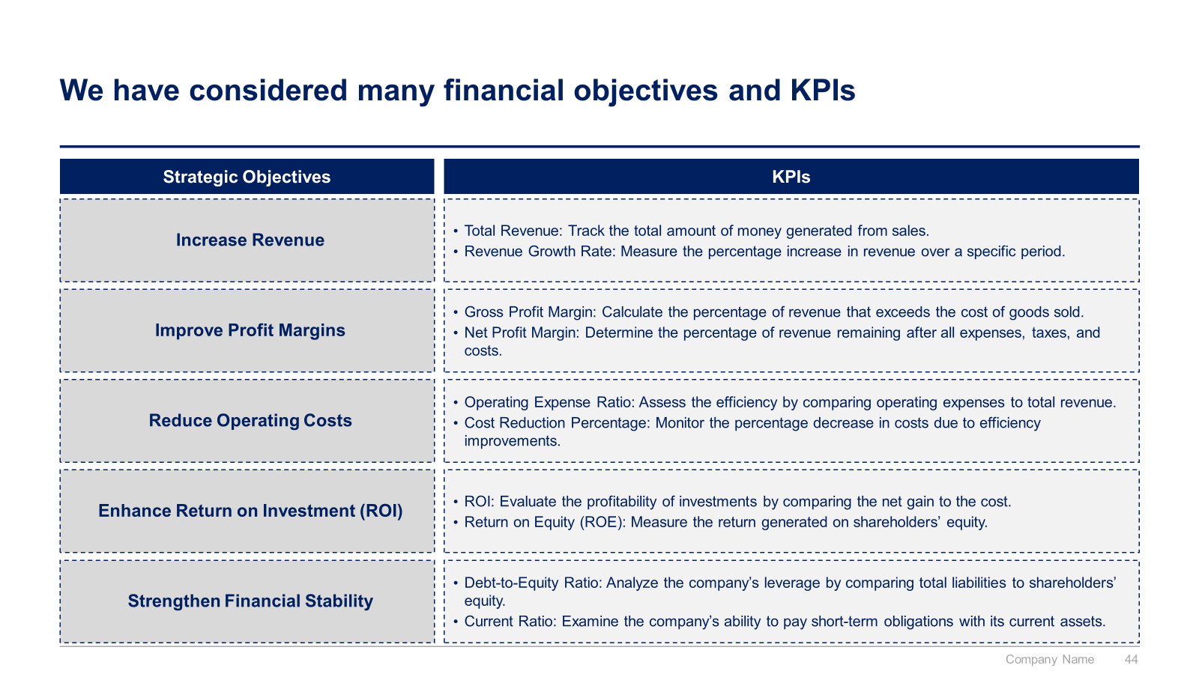
Small preview of the section II “Financial Planning and Analysis (FP&A)” (1/2)

Slide 12
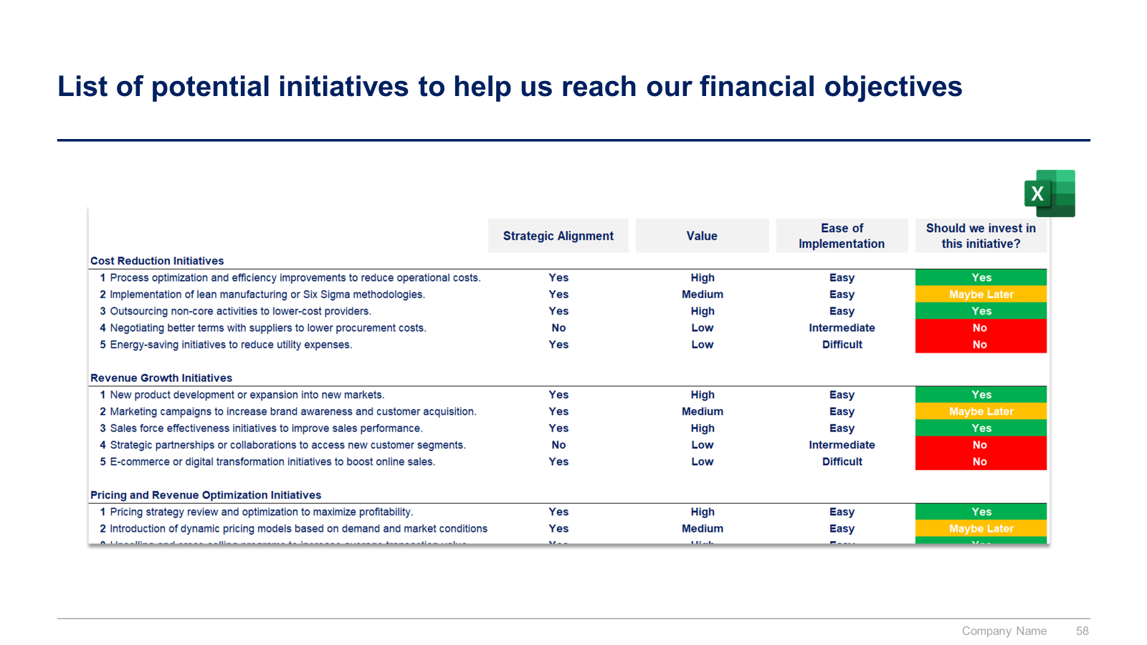
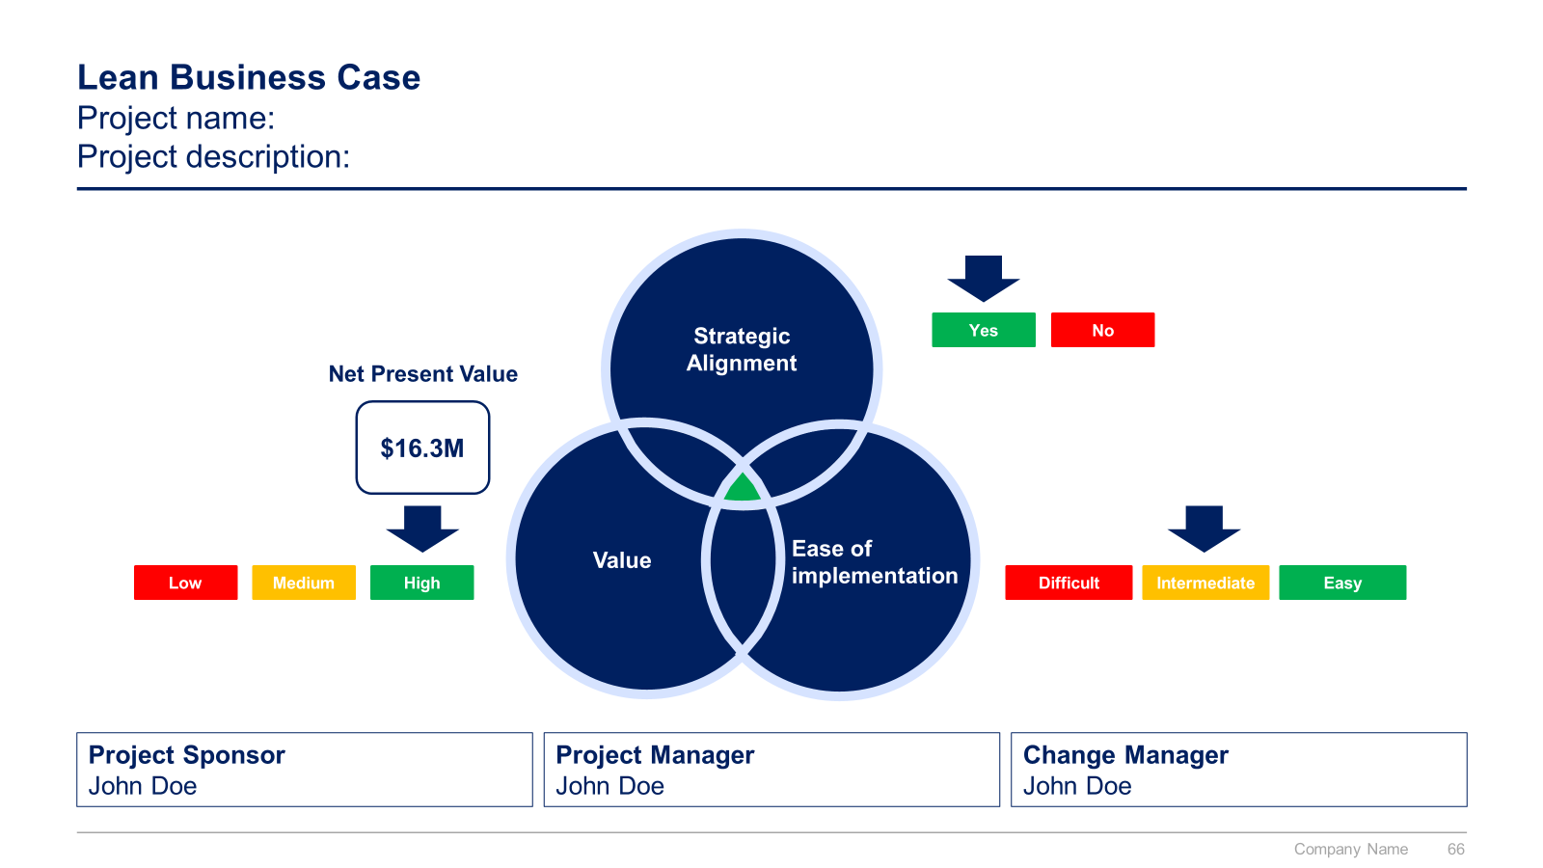
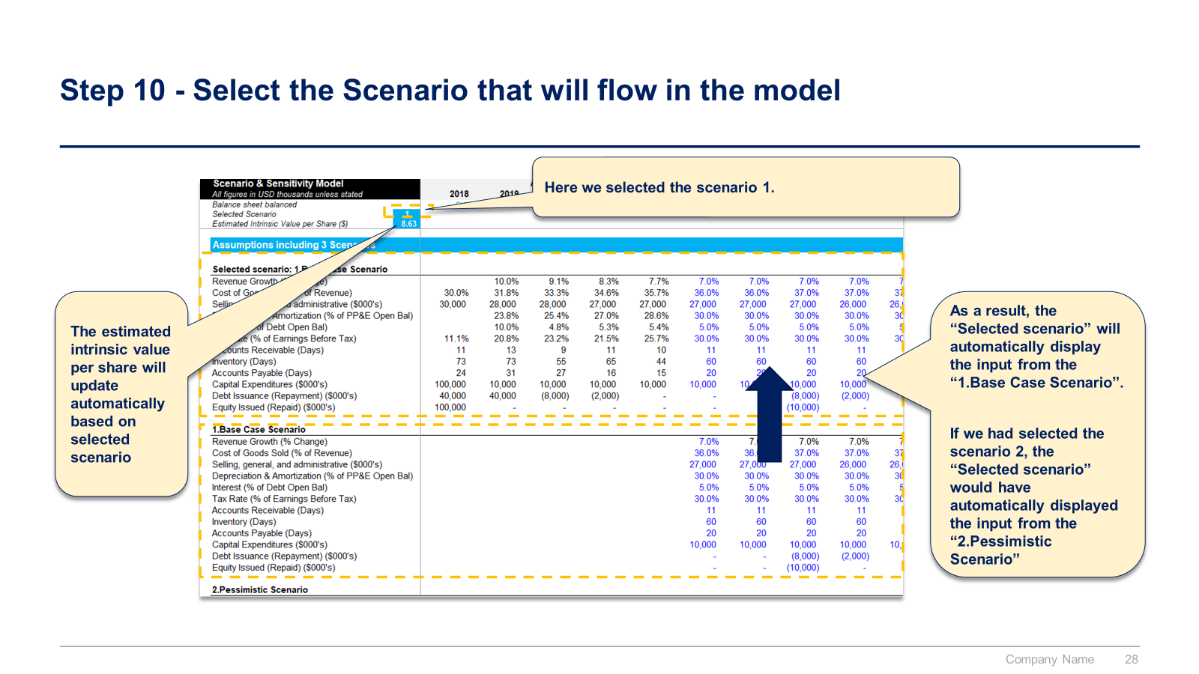
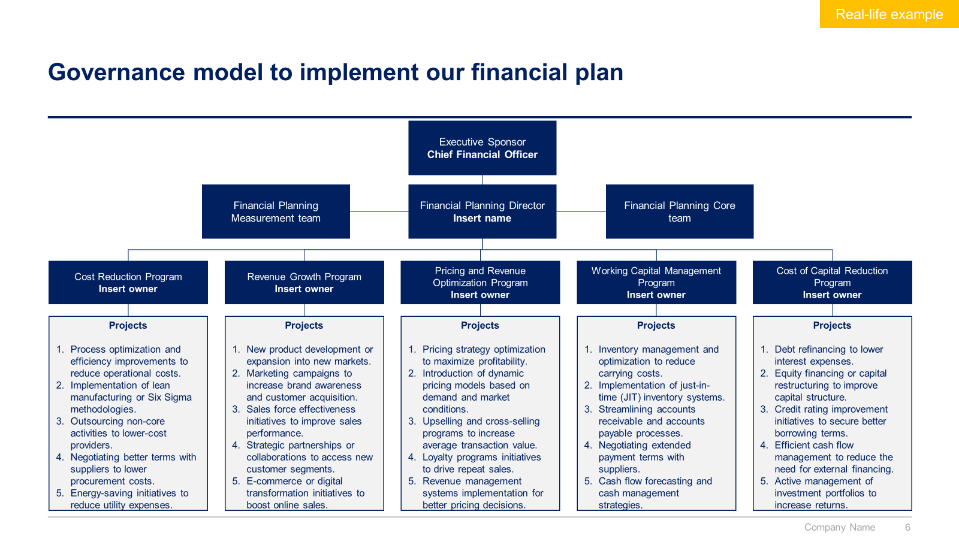
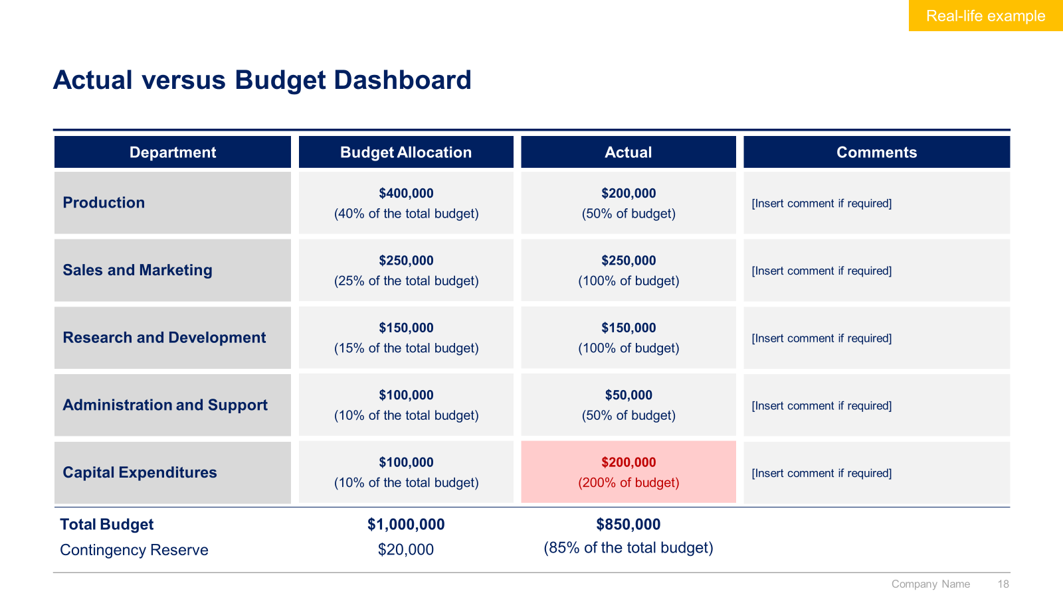
Small preview of the section II “Financial Planning and Analysis (FP&A)” (2/2)

Slide 13



The Toolkit includes multiple PowerPoint slides, Excel sheets and Video training that you can download on your device immediately after purchase
400 editable PowerPoint slides*
62 Excel sheets*
65 minutes of Video training
Overview and Approach
Financial Modeling
Financial Planning and Analysis
*Please note that the number of Powerpoint slides and Excel sheets listed is the number of unique slides and sheets. For example, a Powerpoint slide that has been duplicated to facilitate our clients’ understanding only counts for one slide

Slide 14









Our Management Consulting Toolkits include 9 key benefits
Improve the growth & efficiency of your organization by leveraging Management Consulting Toolkits created by ex-McKinsey, Deloitte & BCG Consultants.
Make a great investment for your career & organization. It cost us US$8M+ over the past 10 years to create all our Toolkits. Get them for a fraction of this cost.
Get a competitive advantage. It’s like hiring Management Consultants to create all the practical Frameworks, Tools & Templates you need.
Get the job done quicker and never start from scratch again with our ready-made and fully editable Frameworks, Tools & Templates in Powerpoint & Excel.
Don't reinvent the wheel. We have already worked 30,000+ hours over the past 10 years to create all the Management Consulting Toolkits you need.
Improve the capabilities of your organization by learning how the Fortune 100 and Global Consulting Firms do it.
Decrease your costs. Hiring tier-1 Consultants for a project would cost you $300k+. Way more expensive than our Toolkits, which will last you a lifetime!
Become your organization’s subject matter expert and impress your stakeholders with world-class approaches to resolve common business problems.
Get free support and advice from our ex-McKinsey, Deloitte & BCG Management Consultants.

Slide 15
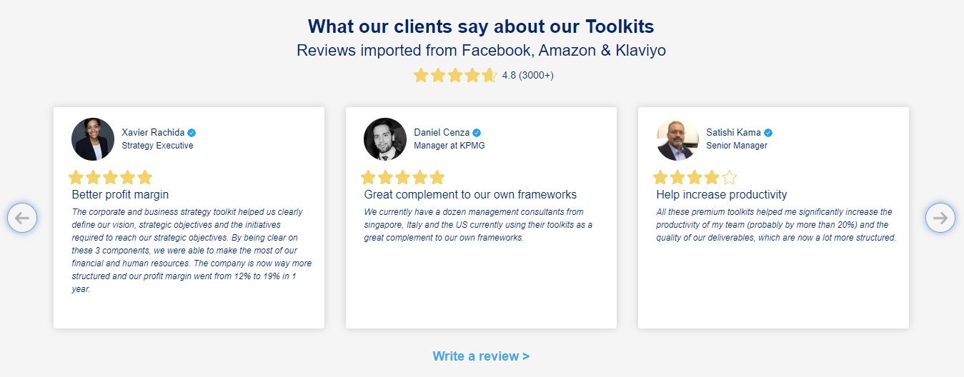
What our clients say about our Toolkits
Click here to see more reviews >

Slide 16

Join 200,000+ Executives, Consultants & Entrepreneurs leveraging our Toolkits to improve the performance of their organization
Trusted by small and large organizations
Customer satisfaction
4.8
Number of countries leveraging our Toolkits
160+
Number of professionals leveraging our Toolkits
200,000+
Daily rate of our ex-McKinsey, Deloitte and BCG Management Consultants
$3k-$4k

Slide 17

Interested in more than 1 Toolkit? Access all our Toolkits for half the price with our Gold Access
Gold Access
Click here to learn more

Slide 18






Need additional help? Send us a brief and we’ll find you the right talent from our network of 500+ tier-1 Management Consultants
Click here to send us a Project Brief

Slide 19

This was just a small preview.
www.domontconsulting.com

